Slide 1

Leveraging Azure Cloud Solutions for Enhanced Business Performance
ΟΜΑΔΑ 3
ΕΥΑΓΓΕΛΙΑ ΜΙΖΙΟΥ
ΚΩΝΣΤΑΝΤΙΝΟΣ ΠΙΣΤΟΛΑΣ
ΔΗΜΗΤΡΙΟΣ ΙΑΤΡΟΥ
ΧΡΗΣΤΟΣ ΓΑΛΛΟΣ
ΑΝΑΣΤΑΣΙΑ ΜΑΡΜΑΡΟΥ

Slide 2
Detailed configuration for each of the services used
WEB APP
SQL DATABASE SERVER
STORAGE ACCOUNT
RULES
FUNCTION APP
FIREWALL
SUBNETS
DIAGNOSTIC SETTINGS
KEY VAULT
IDENTITY PROVIDER

Slide 3
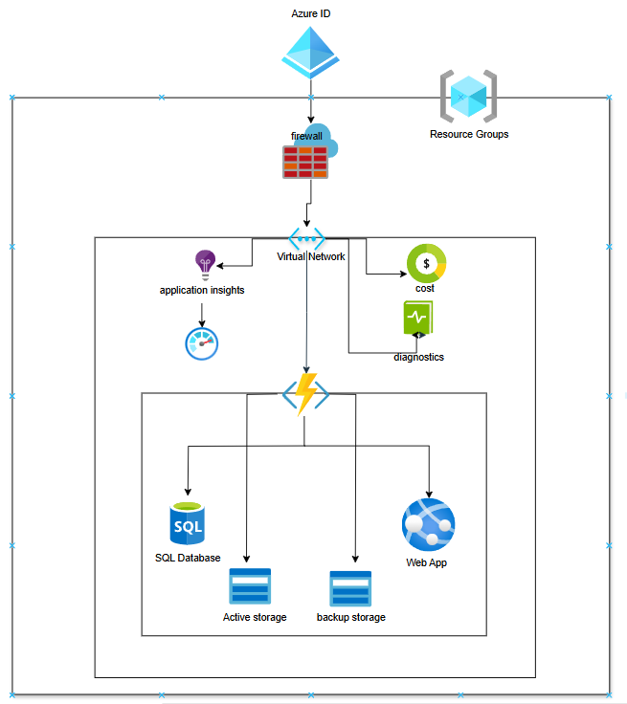
DIAGRAM OF THE CLOUD ARCHITECTURE

Slide 4

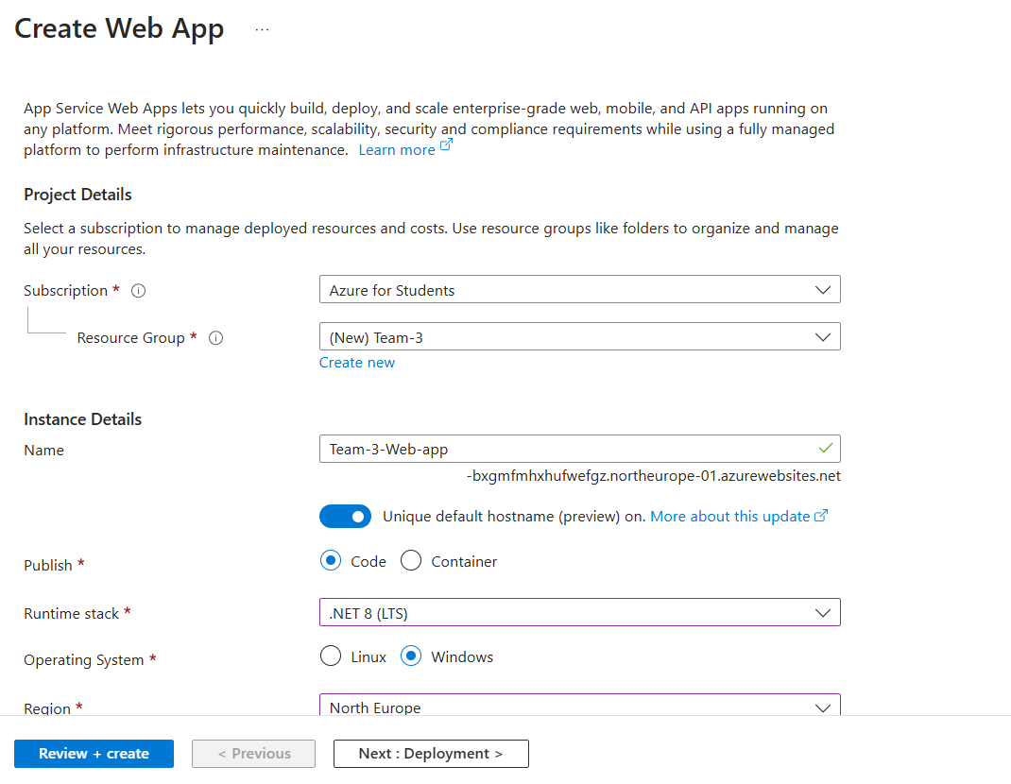
WEB APP
Premium V3 Tier; 1 P0V3 (1 Core(s), 4 GB RAM, 250 GB Storage) x 744 Hours
Windows OS
Authentication Id enabled
Network injection enabled

Slide 5

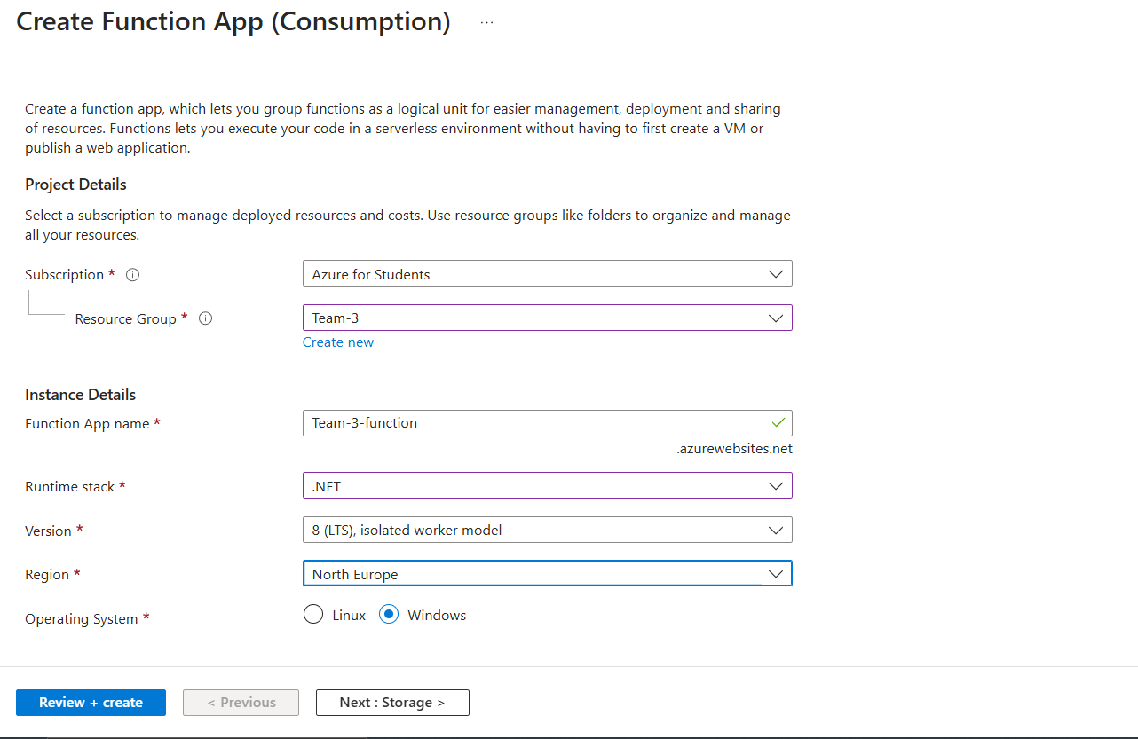
Azure Functions
Consumption tier
Pay as you go
128 MB memory
100 milliseconds execution time
1,000,000 executions/month

Slide 6

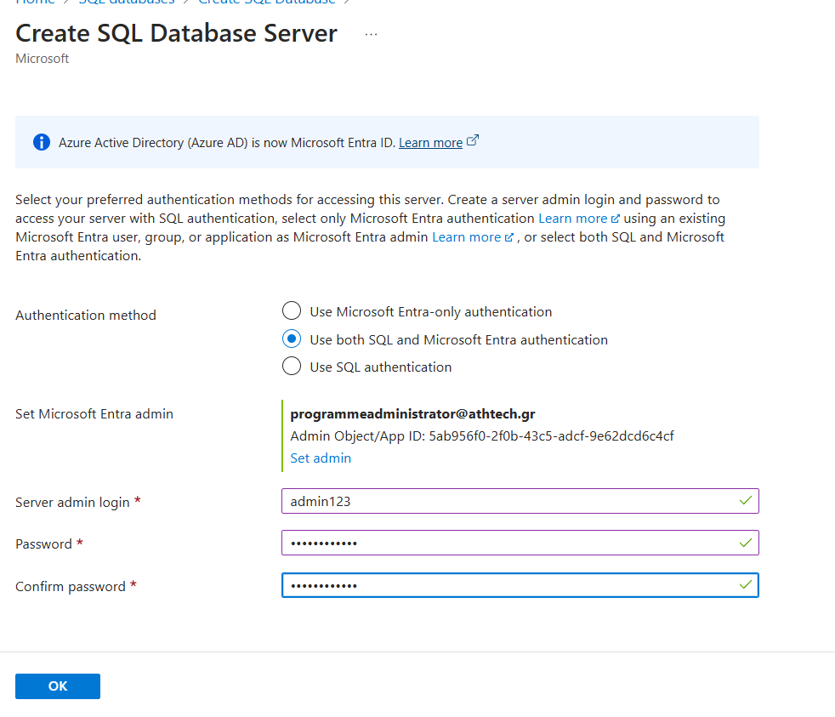
Azure SQL Database
Single Database
VCore
General Purpose
Provisioned
Standard-series (Gen 5)
Primary or Geo replica Disaster Recovery
Locally Redundant, 1 - 2 vCore Database(s) x 744 Hours
32 GB Storage, SQL License (Pay as you go)
RA-GRS Backup Storage Redundancy
0 GB Point-In-Time Restore
0 x 0 GB Long Term Retention

Slide 7

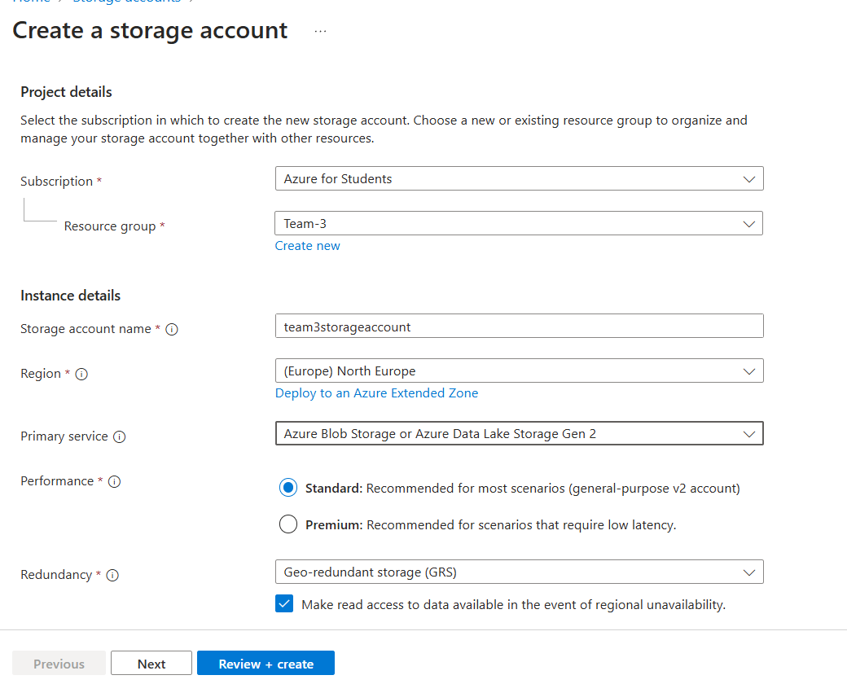
Storage Accounts
Block Blob Storage
General Purpose V2
Flat Namespace
RA-GRS Redundancy
Hot Access Tier
5 TB Capacity - Pay as you go
1 x 10,000 Write operations
10 x 10,000 Read operations
10 x 10,000 Other operations
1,000 GB Data Retrieval
1,000 GB Data Write
SFTP disabled
1000 GB Geo-replication data transfer

Slide 8

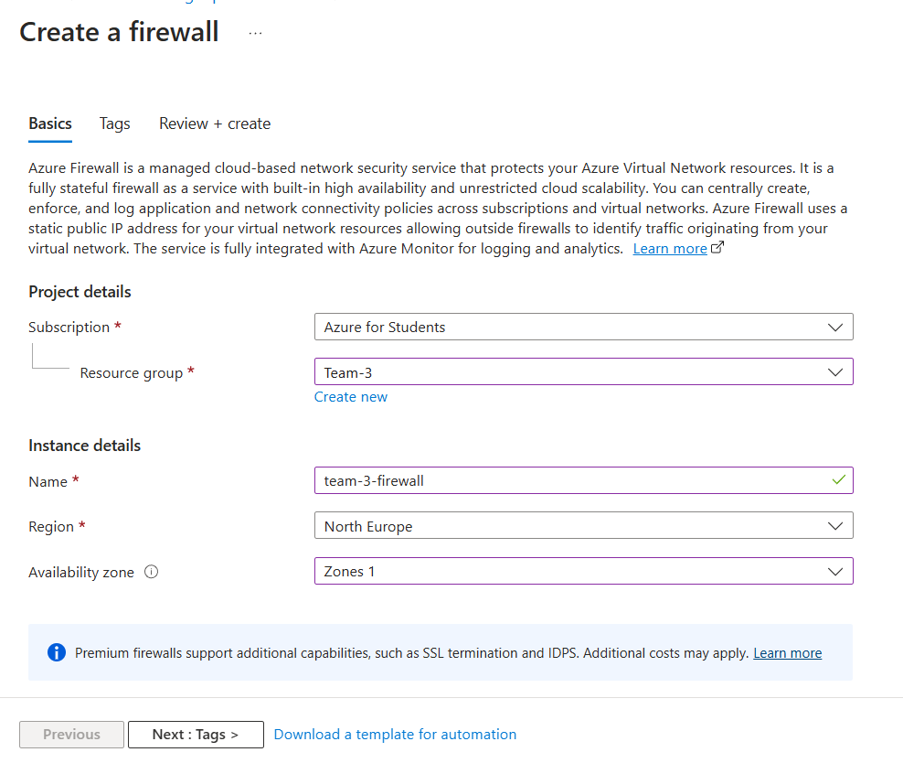
Azure Firewall
Basic tier
1 Logical firewall units x 744 Hours
100 GB Data processed

Slide 9

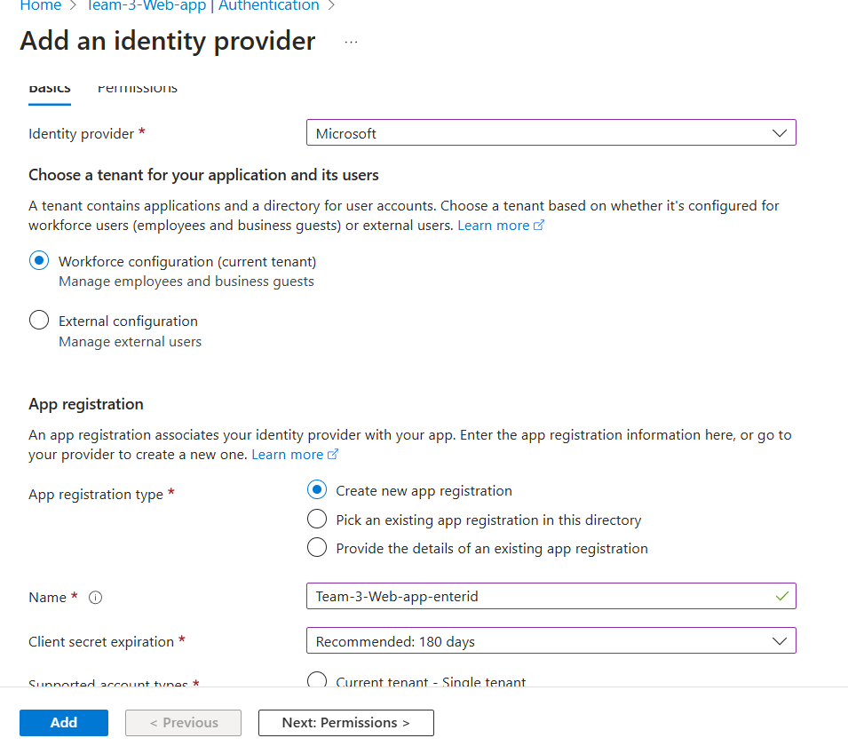
Microsoft Entra ID (formerly Azure AD)
Premium P1 - 350 users
Premium P2 - 1 users
Standard tier
User forest - 744 Hours

Slide 10

Estimated billing

Slide 11
Financial snapshot
Service category | Service type | Region | Estimated monthly cost
Compute | App Service | North Europe | $122,02
Compute | Azure Functions | North Europe | $0,00
Databases | Azure SQL Database | North Europe | $385,04
Storage | Storage Accounts | North Europe | $255,70
Security | Key Vault | North Europe | $30,18
Networking | Azure Firewall | North Europe | $300,38
Identity | Microsoft Entra ID (formerly Azure AD) | North Europe | $2.220,60
Cash reserves |  |  | $3.313,92

Slide 12
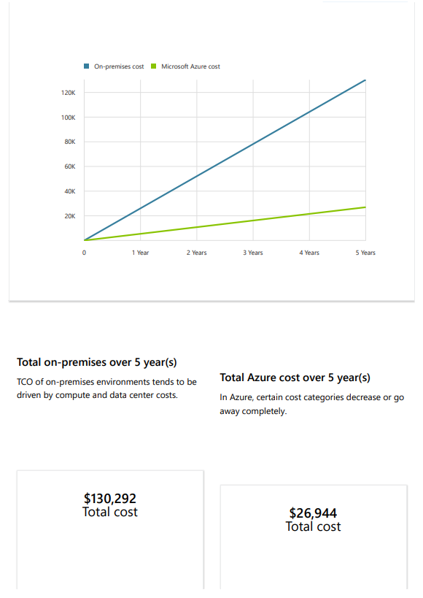
Over 5 year(s) with Microsoft Azure, your estimated cost savings
could be as much as $103,348

Slide 13
Thank You

